Slide 1

Obesity Trends in the US
Holly Huber

Slide 2
Background

Slide 3
Project Summary
I am currently undertaking a project analyzing the obesity epidemic on multiple time and size scales. The objective of this project is to learn relevant analysis methodologies, as well as the coding skills in python necessary for implementation. The multiple scales of time and space that impact human health outcomes are immensely intricate. However, understanding dominant factors at different scales can allow for targeted intervention and effective development of health solutions. One temporal and spatial coordinate I'm investigating is the impact of societal-scale changes over a human lifespan(about 70 years). These societal-scale changes include HFCS production, as a proxy for the rise in processed food, as well as changes in activity levels per day. Another temporal spatial coordinate I'm investigating is the impact of significant changes in energy density, and perhaps nutritional content, of meals in a controlled clinical trial comparing caloric intake per day/meal over the course of two weeks on this diet. It is important to note that inputs on a smaller timescale can be measured against a longer-timescale output via time-series analysis, regression incorporating the cumulative effects of an input through time. Can the same be said spatially? Perhaps, but the complexity triples, as spatial changes are through three axes in space. With Dr. Finley, I will be creating a model on the cellular level at hour long timescales, but with simulation hopefully I'll be able to extend this tool into multiple temporal and spatial scales.

Slide 4
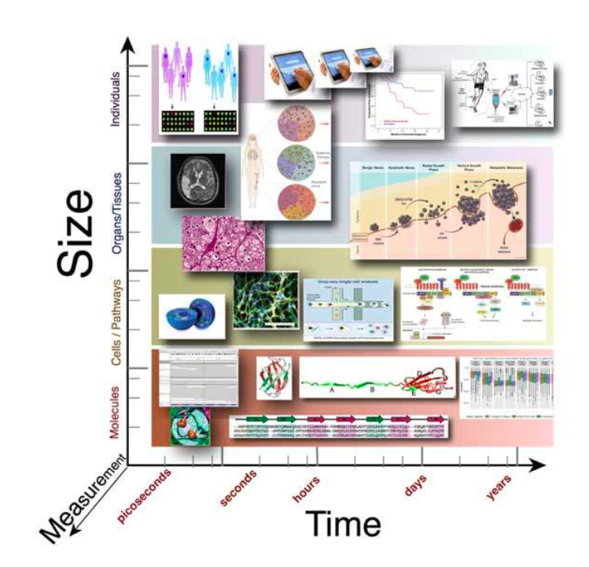
‘Scales’ Lens

Slide 5
Hypotheses, Novelty

Slide 6
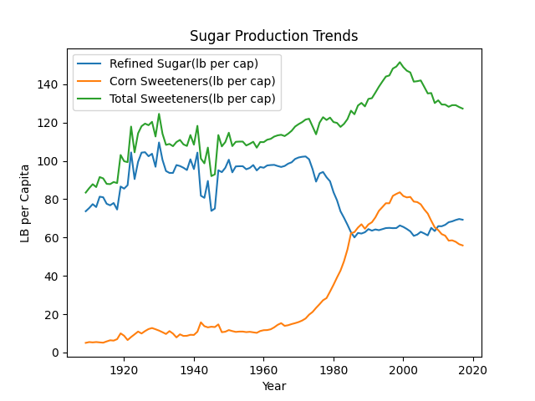
Input/Output

Slide 7
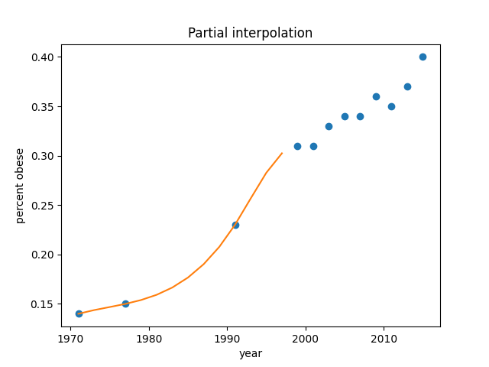
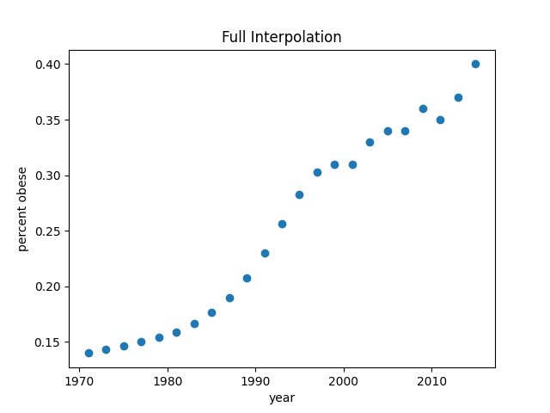
Data Pre-Processing
Weighing to Represent US Population
Interpolation of Data points between 1970-2000:

Slide 8
Data Modeling
Linear regression

Slide 9
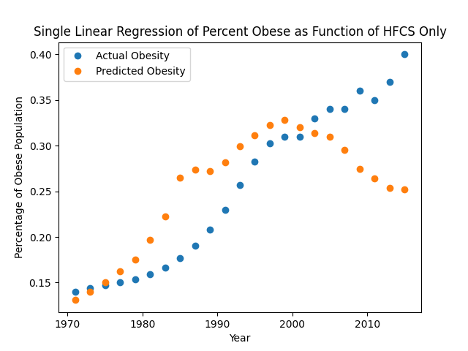
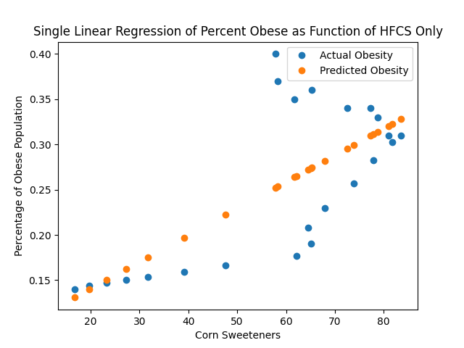
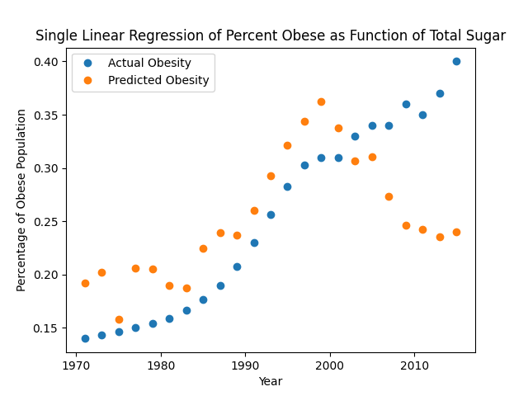
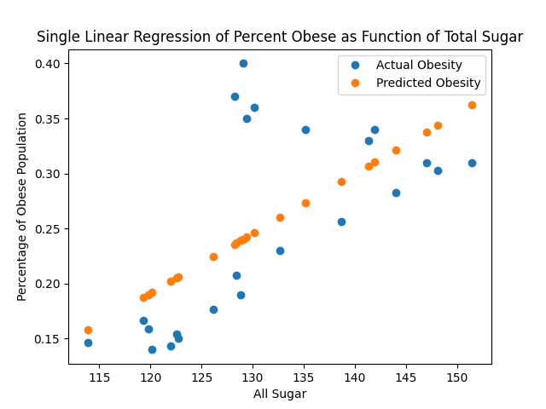
Results – Simple Linear Regression

Slide 10
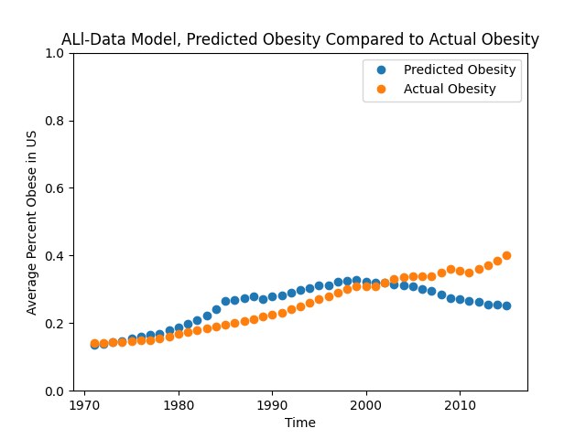
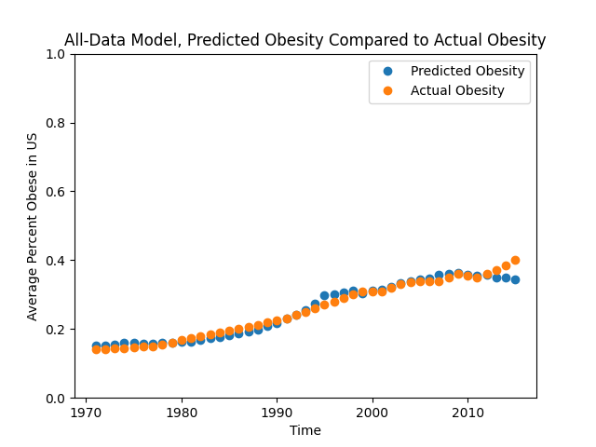
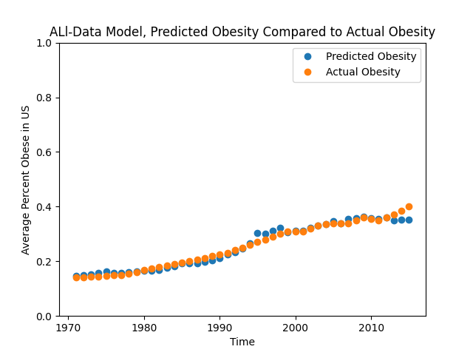
Comparison of Models(HFCS)
Simple regression, HFCS(t)
Two-term regression
Eleven-term regression

Slide 11
Comparison of Model Metrics(HFCS)
Model | Train Data Mean Squared Error | Test Data Mean Square Error | Test/Train Percent Change
HFCS(t) | 0.0006607044505939457 | 0.014696528386197921
HFCS(t) + HFCS(t-1) | 0.0004338604137418649 | 0.009830419790072839
HFCS(t) + HFCS(t-10) | 5.6456818231389344e-05 | 0.0018078497438129676
HFCS(t) + HFCS(t-1) + HFCS(t-2)…HFCS(t-10) | 4.8617499703780733e-05 | 0.0019462291345998706

Slide 12
Optimizing Models – Simple Linear, HFCS
Minimum test error occurs at Obesity = B*HFCS(t-13)
Error = 0.0003131102995664017
Minimum train error occurs at Obesity = B*HFCS(t-10)
Error = .0000976
index | Train Error | Test Error
0 | 0.000660704 | 0.014696528
1 | 0.000525753 | 0.012712112
2 | 0.000417251 | 0.010825972
3 | 0.000324145 | 0.008991403
4 | 0.000255089 | 0.007329829
5 | 0.000195828 | 0.005787192
6 | 0.000155665 | 0.00440029
7 | 0.000132082 | 0.00307343
8 | 0.000113436 | 0.002037017
9 | 0.000101118 | 0.001292536
10 | 9.76E-05 | 0.00077707
11 | 0.000109791 | 0.000466489
12 | 0.000140589 | 0.000333312
13 | 0.000189234 | 0.00031311
14 | 0.000255732 | 0.000398128
15 | 0.00034406 | 0.000512621
16 | 0.000445557 | 0.000733936
17 | 0.000553875 | 0.001021472
18 | 0.000648772 | 0.001811568
19 | 0.00073673 | 0.003205021
20 | 0.000809558 | 0.005838711
21 | 0.000788678 | 0.012431161
22 | 0.000785263 | 0.020802423
23 | 0.0008 | 0.030801669
24 | 0.000927375 | 0.041768573
25 | 0.001028531 | 0.056834525
26 | 0.001162662 | 0.072886638
27 | 0.001326463 | 0.087788896
28 | 0.001582119 | 0.089171981
29 | 0.001993817 | 0.083071396
30 | 0.002182938 | 0.08203285
31 | 0.002338392 | 0.068894182
32 | 0.002515134 | 0.053969674
33 | 0.002681958 | 0.03957917
34 | 0.002829991 | 0.024739647
35 | 0.00299129 | 0.013785329
36 | 0.003081333 | 0.006763087
37 | 0.003207175 | 0.003606531
38 | 0.003390479 | 0.002387036
39 | 0.003465141 | 0.002403882
Why the second minimum at 40? Probably because the test data set is picking up the beginning of the 1980’s trend…the train error should be pretty bad →

Slide 13
Optimizing Models – Simple Linear, HFCS
 | Overall index | index1 | coeff1 | Y-intercept | Test error | Train error
train optimal | 10 | 10 | 0.00280014 | 0.11853542 | 0.00077707 | 0.000097579
test optimal | 13 | 13 | 0.0030467 | 0.12613330 | 0.00031311 | 0.000189233

Slide 14
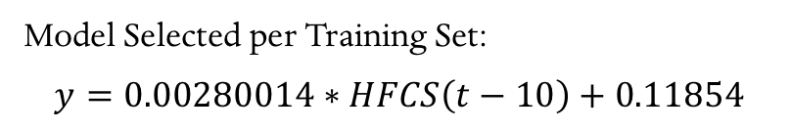
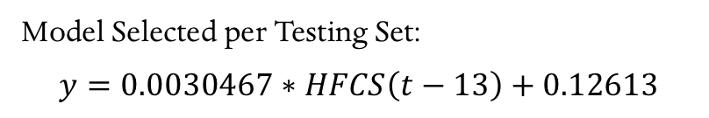
Model Selected per Training Set:
$$y=0.00280014∗HFCS\left(t−10\right)+0.11854$$
Model Selected per Testing Set:
$$y=0.0030467∗HFCS\left(t−13\right)+0.12613$$

Slide 15
Optimizing Models - HFCS, Two Term
 | Overall index | index1 | index2 | coeff1 | coeff2 | Y-intercept | Test error | Train error
train optimal | 14 | 0 | 14 | 0.0011061 | 0.0021120 | 0.097102351 | 0.00104472 | 0.000032724
test optimal | 1206 | 30 | 6 | 0.0026020 | 0.0023747 | 0.080607365 | 0.00005217 | 0.000116403

Slide 16
Shouldn’t this be symmetrical??
Indeed, it ‘tis!

Slide 17
Optimizing Models – Simple Linear, All Sugar
index | Train Error | Test Error
0 | 0.00053743 | 0.01964342
1 | 0.00045835 | 0.01732984
2 | 0.00039855 | 0.01507213
3 | 0.00035949 | 0.01266401
4 | 0.00039634 | 0.01014544
5 | 0.00045075 | 0.00774487
6 | 0.00052411 | 0.00572522
7 | 0.00057262 | 0.00346822
8 | 0.00061407 | 0.00246403
9 | 0.00063193 | 0.00203123
10 | 0.00067465 | 0.00244904
11 | 0.00068919 | 0.00414403
12 | 0.00070952 | 0.00653216
13 | 0.00076313 | 0.00842055
14 | 0.0007971 | 0.01034084
15 | 0.00082738 | 0.01097512
16 | 0.00084925 | 0.01135977
17 | 0.00086856 | 0.00968365
18 | 0.00086601 | 0.00961854
19 | 0.00086517 | 0.00900948
20 | 0.00086155 | 0.00674866
21 | 0.00106029 | 0.00493893
22 | 0.00106353 | 0.003201
23 | 0.00098226 | 0.00217046
24 | 0.00100269 | 0.0019308
25 | 0.00138465 | 0.00205461
26 | 0.00152985 | 0.00325886
27 | 0.00160154 | 0.00319243
28 | 0.00162022 | 0.00353032
29 | 0.00164312 | 0.00351096
30 | 0.00215982 | 0.00477592
31 | 0.00209721 | 0.00586857
32 | 0.00237907 | 0.00668716
33 | 0.00260261 | 0.0063521
34 | 0.00286475 | 0.00595612
35 | 0.00319987 | 0.00633589
36 | 0.0034941 | 0.00703341
37 | 0.0036955 | 0.00813867
38 | 0.00386277 | 0.00957146
39 | 0.0039745 | 0.01110741

Slide 18
Optimizing Models – Two Term, HFCS
Minimum error occurs at Obesity = B*HFCS(t) + B*HFCS(t-20)
Error = 0.0002643595158237177

Slide 19
Optimizing Models – Two Term, HFCS
Minimum error occurs at Obesity = B*HFCS(t-30) + B*HFCS(t-6)
Error = 5.2174805897351754e-05 or .00005217

Slide 20
Estimating Models – HFCS, One Term
 | index1 | coeff1 | Y-intercept | Test error | Train error
train optimal | 10 | 0.0028001 | 0.118535423 | 0.00077707 | 0.00009.75798170
test optimal | 13 | 0.0030467 | 0.126133304 | 0.00031311 | 0.0001892335674

Slide 21
Optimizing Models – HFCS, One Term

Slide 22
Optimizing Models - HFCS, Two Term
 | Overall index | index1 | index2 | coeff1 | coeff2 | Y-intercept | Test error | Train error
train optimal | 14 | 0 | 14 | 0.0011061 | 0.0021120 | 0.097102351 | 0.00104472 | 0.000032724
test optimal | 1206 | 30 | 6 | 0.0026020 | 0.0023747 | 0.080607365 | 0.00005217 | 0.000116403

Slide 23
HFCS, Two-Term Test/Train Error
Shouldn’t this be symmetrical??
Indeed, it ‘tis!

Slide 24
HFCS Model Specs
Three Term -
Model Optimized on Train Error, train error: 5.407779253981112e-06
Model Optimized on Train Error, test error: 0.0007589751239509658
Model Optimized on Train Error, indices: 11 0 18
Model Optimized on Train Error, coefficients: [0.00125102 0.00099929 0.00109104]
Model Optimized on Train Error, intercept: 0.09635570686152084
Model Optimized on Test Error, train error: 4.5360971678287764e-05
Model Optimized on Test Error, test error: 2.3950255430962097e-05
Model Optimized on Test Error, indices: 30 10 2
Model Optimized on Test Error,coefficients: [0.00218963 0.00154582 0.00106737]
Model Optimized on Test Error, intercept: 0.07938754970983863

Slide 25
Optimizing Models – All Sugar, Two Term
 | Overall index | index1 | index2 | coeff1 | coeff2 | Y-intercept | Test error | Train error
train optimal | 480 | 12 | 0 | 0.0043317 | 0.0032888 | -0.730241527 | 0.00147938 | 0.0000963730208
test optimal | 220 | 5 | 20 | 0.0036864 | 0.0049054 | -0.811965175 | 0.00018531 | 0.0001920102255

Slide 26
Optimizing Models – All Sugar, Two Term, Error

Slide 27
All Sugar Model Specs
Two Term | Overall index | index1 | index2 | coeff1 | coeff2 | Y-intercept | Test error | Train error
train optimal | 480 | 12 | 0 | 0.0043317 | 0.0032888 | -0.730241527 | 0.00147938 | 0.0000963730208
test optimal | 220 | 5 | 20 | 0.0036864 | 0.0049054 | -0.811965175 | 0.00018531 | 0.0001920102255
 | Overall index | index1 | index2 | index 3 | coeff1 | coeff2 | coeff3 | Y-intercept | Test error | Train error
train optimal | 16520 | 10 | 13 | 0 | 0.002242 | 0.002383 | 0.003024 | - 0.7329179 | 0.001174088943885859 | 5.0237461129080037e-05
test optimal | 4056 | 2 | 21 |  | 0.00314017 | 0.00208617 | 0.0036982 | -0.85909527 | 3.0544441933921286e- | 0.00012561693000718972

Slide 28
Model Selection
Model (HFCS Predictor, Best Train Error) | Test Error | Train Error
Simple Linear Regression | 0.00077707 | 0.000097579
Two-Term Linear Regression | 0.00104472 | 0.000032724
Three-Term Linear Regression | 0.0007589751239509658 | 0.00000540777925398111
Four-Term Linear Regression
Five-Term Linear Regression
Model (All Sugar Predictor, Best Train Error) | Test Error | Train Error
Simple Linear Regression | 0.01266401 | 0.00035949
Two-Term Linear Regression | 0.0014793871161857242 | 0.000096373
Three-Term Linear Regression | 0.0011740889438858592 | 0.000050237
Four-Term Linear Regression
Five-Term Linear Regression
Notes:
Overall, it seems that HFCS has more predictive capabilities that total sugar production, when applying linear, time-delayed models. This superior predicting power of HFCS pattern is sustained not only in the best HFCS

Slide 29
Discussion
Generally, obesity cannot be a negative value
Generally, a model with predictive power will have agreement between the test and train data set, or similar test/train errors.
One sees a pattern of extreme time-shift when optimizing for the test dataset, as compared to the train dataset. Overall, an ~10 year lagged linear relationship is a better predictor of changes in the percent of the population that’s obese.
Is there a way to model obesity as a probability, with increasing HFCS production increasing likelihood of someone becoming obese?
Now, model says “this much HFCS leads to this percentage of obesity in the population”
Spatial map of percentage obese, as probability that a resident will be obese…
Too many uncontrolled variables currently, one ought to investigate other population factors in ‘effect quantification’ study.
Overall, the model does not seem to be able to predict the continued increase in obesity after 2010, though HFCS, surprisingly, seems to be a better predictive model that all sugar production. Perhaps another factor to consider is the price of HFCS compared to other sugars…a change in price means more consumption(more efficient conversion of production to consumption)

Slide 31
Thoughts on Error
Generally, it seems as if the all-sugar test error hops significantly more than the HFCS test error…would one expect a more predictable model to have a smoother error landscape? Or a less smooth error landscape?
I would imagine sharp hops/discontinuities would indicate a feature that is not captured in the current model. I also wonder at the fact that the train error seems to vary less through time for the HFCS data set, compared –AH! Scale!! Diddly.

Slide 32
Discussion
The dramatic HFCS production increase occurred over a 40 year time-span, and the last 20 years have seen a marked decrease in production.
If sugar production predicts obesity, then one would intuitively expect a decrease, if time-delayed, in obesity numbers. However, that assumes that putting on weight is as easy as losing it, which we know is not the case…
Instead, it would seem that obesity should be modeled as a function of additional sugar production PLUS itself…

Slide 33
Discussion – Code Optimization
The run time of the optimization code went up (exponentially?) with the terms added. The combinations considered went from 40, to 1600, to 64000…one should divide by 2 and 3 on the 1600 and 6400 options to correct for repeated terms, but the current code doesn’t do this.

Slide 34
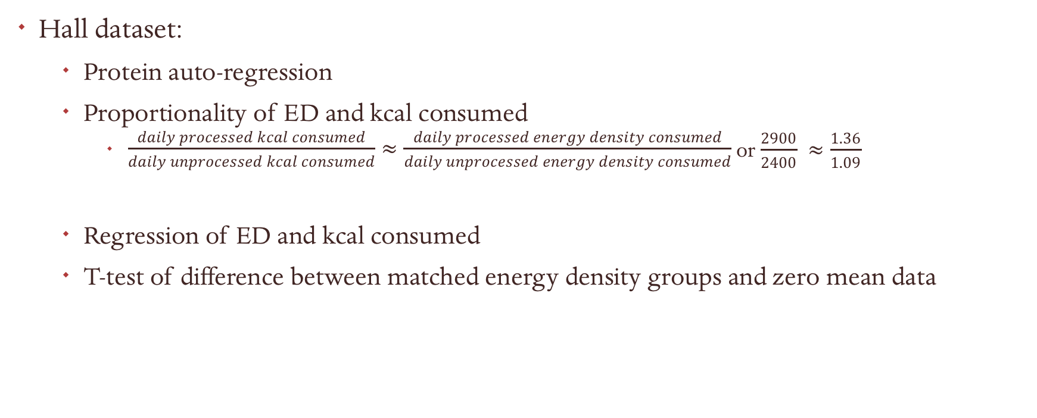
Hypotheses, Novelty
Hall dataset:
Protein auto-regression
Proportionality of ED and kcal consumed
$\frac{daily processed kcal consumed}{daily unprocessed kcal consumed}≈\frac{daily processed energy density consumed}{daily unprocessed energy density consumed}$ or $\frac{2900}{2400} ≈\frac{1.36}{1.09}$
Regression of ED and kcal consumed
T-test of difference between matched energy density groups and zero mean data

Slide 35
Counterfactual Hypothesis formation
“If blank had not happened, then blank result would not have happened”
Formulation that allows for clear testing of causality

Slide 36
Variable Breakdown
Huge amount of independent and dependent variables that are relevant on different scales

Slide 37
Variable Categorization
Understand independent v dependent variables, and exogenous and endogenous variables.
Independent – controlled inputs
Dependent – measured outputs
Exogenous – uncontrolled(though hopefully observed) inputs
Endogenous – measured/predicted variable of system
Why so important? Cell theory is relatively new – only since 1800s did we understand that life is made up of smaller components, cells. Before, people believed that life sprung from non-living things, like maggots from fish, bacteria from broth. An exogenous variable here? Flies laying eggs, bacteria contamination. Inputs outside the system that are the true causes of the observed changes in the measured variable

